Slide 1
Benefits of Agile over Waterfall
Ryan Sizemore
4/17/2021

Slide 2

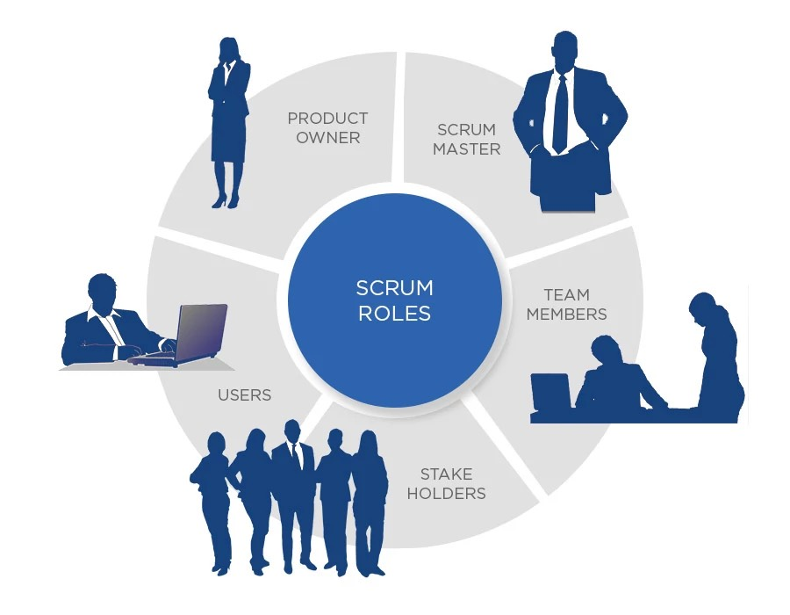
Agile
Who is it?
Notes:
Image via https://www.velvetech.com/blog/agile-app-development/
In an agile team, you have product owners who are responsible for communicating to stake holders and users, gathering user stories, and passing this information to the rest of the team to assist in accurate development of the product.
The scrum master is responsible for ensuring the team members are in the best position possible to get the job done. This could include gathering answers to questions, providing the team with technology that could influence the development, as well as leading scrum events such as stand ups and sprints that communicate progress and create openness amongst the team.
The team members include developers and testers. Developers will create the code for the application/product. The testers will take user stories, develop tests that verify the user story is being addressed in the current version of the application in testing, and provide feedback regarding the tests to the scrum master and the developers, so as to update the product backlog.
Users are people that are either commissioning the product, or could even be people we have set up interviews with that could be interested in the product or are currently using a competing product. We use these interviews called ‘user stories’ to gain an idea on what the users expect out of our product.
“Stake holders can be a range of wide In Agile development stakeholders can be represented by a wide range of people interested in project results:
People funding the project;
Business Managers and Business Architects;
Data Architects and Database Administrators;
Portfolio and Project Managers;
Direct and indirect Users;
Account and Sales Managers;
Developers’ team including Engineers, Designers and PM/BA, etc.” (Exposit, 2021)

Slide 3

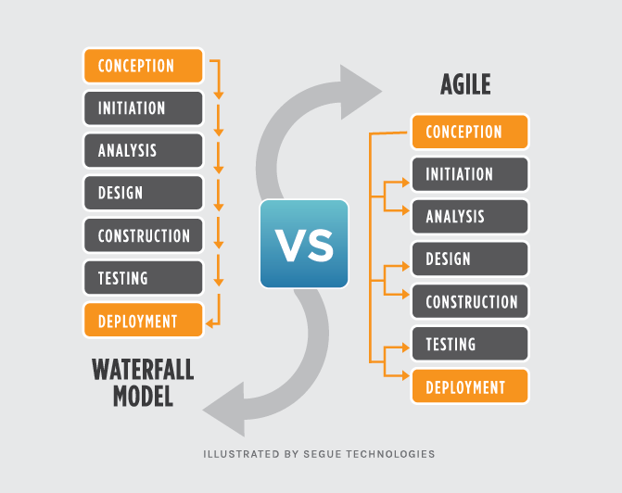
Agile vs Waterfall
The Process
Notes:
Image via https://www.seguetech.com/waterfall-vs-agile-methodology/
Here we can see a side by side comparison on how the same project can be approached using the agile methodology and the waterfall method. The waterfall method is, as the name implies, a linear approach, where each event is dependent on the events prior.
In Agile we will see that multiple stages can be going on at the same time. We will see an increased transparency to the customer where the goal is to deliver updates early and often, so that changes can be made as soon as possible. The results are constantly being monitored and feedback is given as soon as possible.
For example, in the SNHU Travel Project, we are able to look at design and construction congruently as opposed to creating a full wireframe and then coding 100% based off of that.

Slide 4

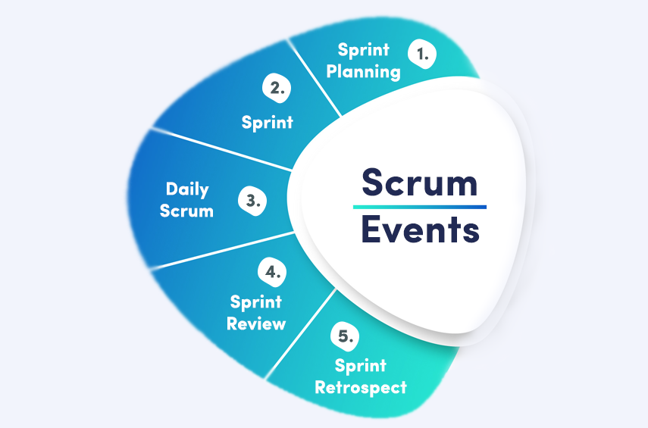
Scrum events
When and what
Notes:
Image via https://agilemania.com/blog/what-is-scrum/
Here is a traditional outline of small events that help define the scrum approach of agile methodology.
We begin with sprint planning where we look at user stories, set the definition of done for these user stories, and set a time box for when we need these stories to be complete.
The sprint then begins where work is started to meet the goal of finishing the artifacts in the sprint that were agreed upon in the sprint planning meeting. Sprints typically last a number of weeks.
Daily scrum events are optional, depending on the teams agreements. This is when the members of the scrum team come together to give updates on where their progress is. These can be in the form of stand ups. These are also time boxed events designed to openly discuss progress and possible inhibitions.
The sprint review and retrospective reflects on what was accomplished during the sprint, and see how this compares to the product backlog. After a sprint ends, we being the process over again.

Slide 5
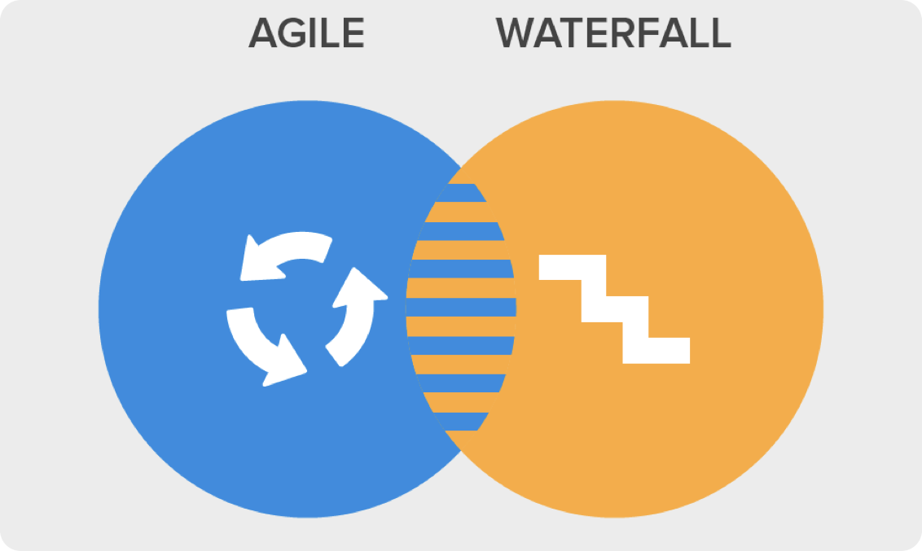
Choosing Agile or Waterfall
How to know
Notes:
Image via https://www.triveniit.com/blog/waterfall-agile-modern-world/
It can be tough to decide when to use agile over waterfall. There are a few key features to consider that should help influence your decision.
It is best to use Agile when:
“When there is a high level of risk or uncertainty;
The project scope is hard to define and changes are likely to happen;
Time to Market is crucial to success;
The market evolves at a fast pace;
You deal with new tech or unfamiliar domains;” - (Zinchenko, 2021)
If you find yourself answering no to several of these, along with the need to work on a fixed budget, waterfall may be the better approach for your project.

Slide 6
References
Admin. (2016, April 5). Comparison of Waterfall and Agile Methodologies. Triveni IT. https://www.triveniit.com/blog/waterfall-agile-modern-world/.
Carrington, M. (2021, February 18). Agile app development: 8 easy steps to ruin your mobile app. https://www.velvetech.com/blog/agile-app-development/.
Exposit. (2020, September 4). Key Stakeholders in Agile Product Development. Exposit. https://www.exposit.com/blog/key-stakeholders-agile-product-development/.
Lotz, M. (2018, November 20). Waterfall vs. Agile: Which Methodology is Right for Your Project? Segue Technologies. https://www.seguetech.com/waterfall-vs-agile-methodology/.
Singh, N. K. (2021, February 11). What is Scrum? A Guide to Understanding Scrum. Agilemania. https://agilemania.com/blog/what-is-scrum/.
Zinchenko, P. (n.d.). Agile vs Waterfall: how to choose the best model for your project? – MindK blog. Web and Mobile Development Blog MindKcom. https://www.mindk.com/blog/agile-vs-waterfall/.

